Slide 1

Introduction to the Python Wordle Game Project
In this project, we'll create a classic Wordle game using the Python programming language. Wordle is a popular online word guessing game where players try to guess a secret 5-letter word in a limited number of attempts.
Presented by : Sujal Rathor 22SCSE1011245 Ankit Singh 22SCSE1011473

Slide 2

Game Objective and Rules
1
Objective
2
Rules
3
Gameplay
Guess the secret 5-letter word in 6 attempts or fewer.
Each guess must be a valid 5-letter word. The game provides feedback on which letters are correct, incorrect, or in the wrong position.
Players take turns inputting their guesses until they correctly identify the secret word or run out of attempts.

Slide 3
Setting up the Development Environment
Install Python
Choose an IDE
Set up Version Control
Begin by ensuring you have the latest version of Python installed on your system.
Select a suitable Integrated Development Environment (IDE) such as Visual Studio Code or PyCharm to write and run your Python code.
Initialize a Git repository to track changes and collaborate effectively on the project.

Slide 4
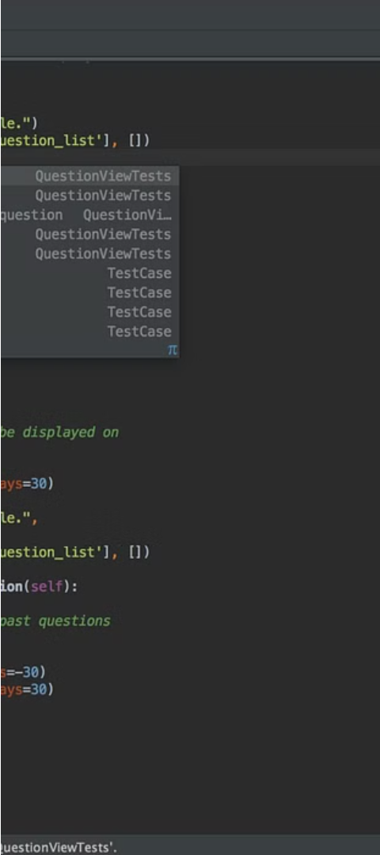
Implementing the Game Logic
1
Generate the Secret Word
Randomly select a 5-letter word from a pre-determined list to serve as the secret word for the game.
2
Process User Guesses
Compare the user's guess to the secret word and provide feedback on the correctness of each letter.
3
Manage Game State
Track the number of attempts, the player's guesses, and the overall game progress.

Slide 5
Handling User Inputs and Validations
Validate Input
Handle Edge Cases
Provide Feedback
Ensure the user's guess is a valid 5-letter word by checking against a comprehensive word list.
Account for scenarios where the user enters invalid inputs, such as non-alphabetic characters or words of incorrect length.
Give the user clear and informative feedback on the validity of their guess and the game's progress.

Slide 6



Providing Feedback and Hints
Correct Letters
Correct Letters, Wrong Position
Incorrect Letters
Indicating the letters in green color that are in the correct position in the secret word.
Showing the letters in red color that are not present in the secret word.
Highlighting the letters in yellow color that are part of the secret word but in the wrong position.

Slide 7



Incorporating a Word Database
Fetch Word List
Validate Guesses
Select Secret Word
Retrieve a comprehensive list of 5-letter words from a reliable source or database.
Check each user guess against the word list to ensure it is a valid word.
Randomly choose a word from the database to serve as the secret word for the game.

Slide 8
Conclusion and Next Steps
Conclusion
Next Steps
Further Improvements
In this project, we've developed a functional Wordle game using Python, incorporating game logic, user input handling, feedback, and a word database.
Consider adding additional features such as a scoring system, difficulty modes, or the ability to save and resume games.
Explore ways to optimize the game's performance, add more engaging visuals, or integrate it with a web or mobile application.

Slide 9
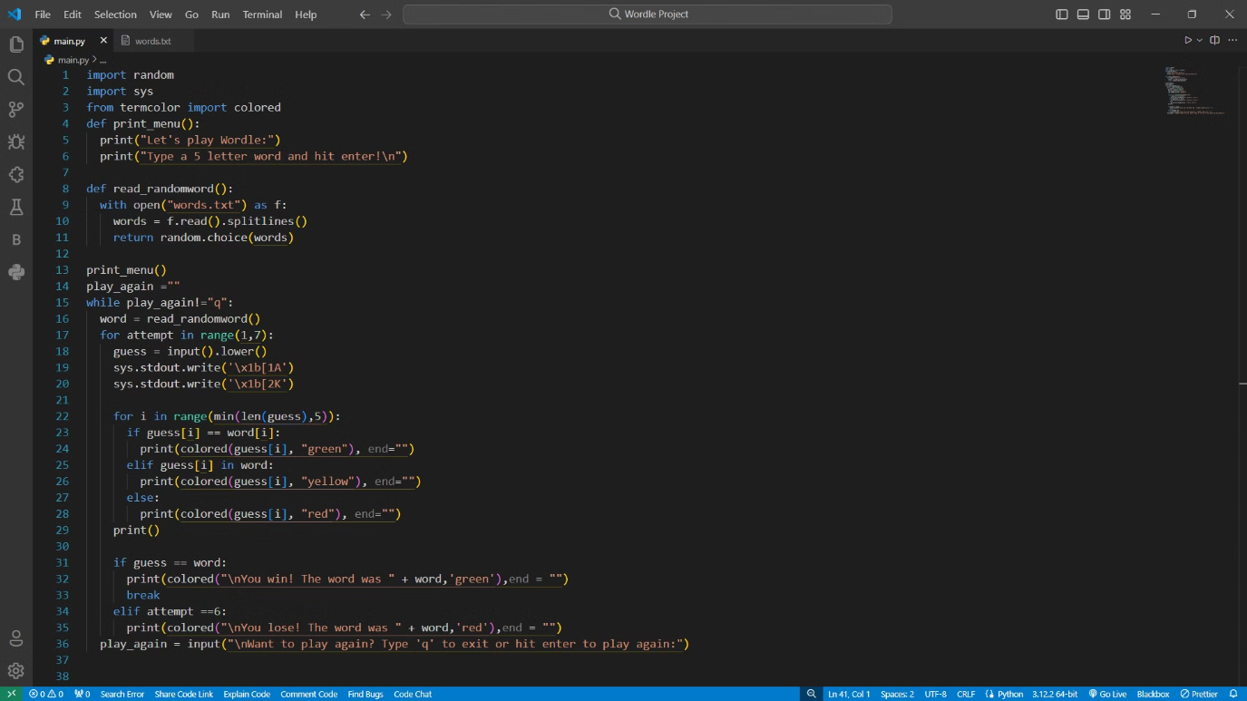
Python Code Of Wordle Game

Slide 10
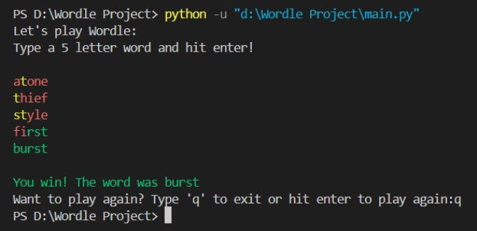
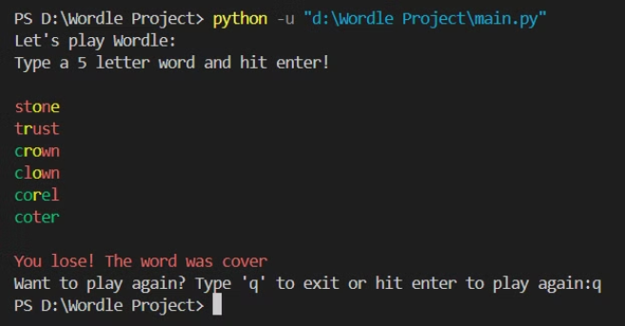
Output
guessed the correct word.
guessed the incorrect word.

